Slide 1



Python Programming: Introduction & Installation
General Purpose Language:
Machine Learning AI
GUI, Web, Software Dev
Download Install & Run:
https://www.python.org
Start > Python IDLE
Write a line of code
e.g. 2+3 OR print(“Hello World”)
Python Features:
Interpreted
Object oriented
High Level
Current version 3.x
Community version of PyCharm IDE:
https://www.jetbrains.com/pycharm/download
Install 64 bit (depending on system)
Start > PyCharm > Create New Project > filename.py
print(“Hello World”)
Run the file
CONCEPTION >> PRACTICE >> CONFIDENCE >> HIGHEST GRADES © PROTECTED ANODIAM 2023 || PRIVATE & CONFIDENTIAL

Slide 2
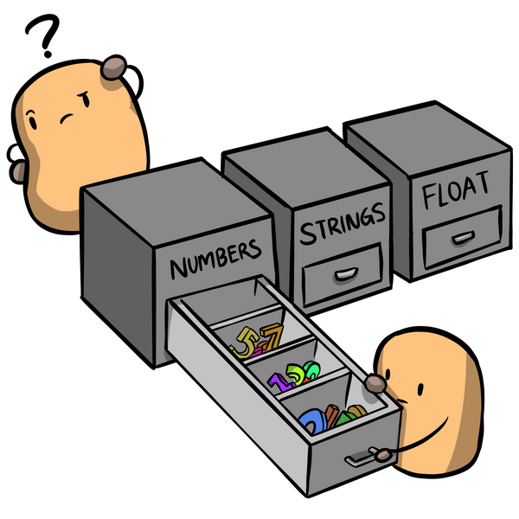
Python Programming: Variables & Strings
Types:
int e.g. 4, 1000, -34 etc.
float e.g. 33.4, -0.0005
string e.g. ‘My friend Tom’, ‘cricket’ etc.
Assignment:
x = 2
name = ‘Rupa’
Strings:
Strings are immutable:
str1 = “My Name”
str1[3] = ‘n’ # Error
A | n | o | d | i | a | m |  | R | o | c | k | s
0 | 1 | 2 | 3 | 4 | 5 | 6 | 7 | 8 | 9 | 10 | 11 | 12 | àindex
-13 | -12 | -11 | -10 | -9 | -8 | -7 | -6 | -5 | -4 | -3 | -2 | -1
CONCEPTION >> PRACTICE >> CONFIDENCE >> HIGHEST GRADES © PROTECTED ANODIAM 2023 || PRIVATE & CONFIDENTIAL

Slide 3
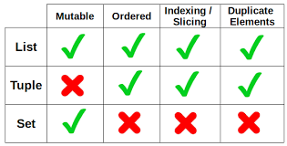
Python Programming: Lists, Tuples & Sets
Lists: [ ]
Mutable
E.g.: myList = [23, 91, 9, 507]
Functions used in List:
append()
insert()
remove()
pop()
clear()
extend()
max(list)
min(list))
sum(list))
sort()
sort(reverse=True)
Tuples: ( )
Immutable
Iteration is faster than list
E.g.: myTuple = (23, 91, 9, 507)
Sets: { }
Like mathematical sets: do not consider repetition
E.g.: mySet = {23, 91, 9, 507, 91}
Uses hashing for performance
No index for sets
Mutable
Functions used in Set:
add()
remove()
set1.update(set2)
CONCEPTION >> PRACTICE >> CONFIDENCE >> HIGHEST GRADES © PROTECTED ANODIAM 2023 || PRIVATE & CONFIDENTIAL

Slide 4
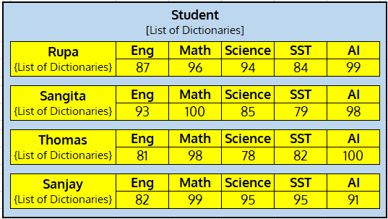
Python Programming: Dictionaries
Dictionaries: { key : value }
Key must be unique and immutable
Key can ne numeric or non-numeric
Access values through key/get( ) function
Can zip 2 lists (key-list & value-list) to form a dictionary
Real Life dictionaries can have nested lists, tuples, sets &
other dictionaries inside
CONCEPTION >> PRACTICE >> CONFIDENCE >> HIGHEST GRADES © PROTECTED ANODIAM 2023 || PRIVATE & CONFIDENTIAL

Slide 5
Python Programming: Variables
Variables Trivia:
num = 3
id(num)
name = ‘Rupa’
id(name)
Two variables assigned same values: a = 5, b=5
id(a) will therefore point to the same memory as id(b)
Constants:
Actually variables with names in CAPS e.g. PI = 3.14
Garbage Collection:
Unused objects and variables are garbage collected by Python
CONCEPTION >> PRACTICE >> CONFIDENCE >> HIGHEST GRADES © PROTECTED ANODIAM 2023 || PRIVATE & CONFIDENTIAL

Slide 6
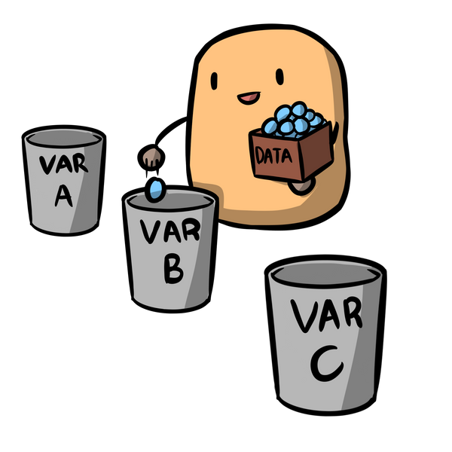
Python Programming: Data Types & Operators
Data Types:
None: var not assigned (null)
Numeric:
Int
Float
Complex e.g. 6+4.5j
Bool True, False
List
Tuple
Set
String
Range
Dictionary
** Character data type absent in Python
Types of Operators :
Arithmetic e.g. + - * / % etc.
Assignment assigning values ( = )
Relational compare two variables ( “>” “<“ “==“ “>=“ “<=“ “!=“ )
Logical “AND” “OR” “NOT”
Unary negating a value
Bitwise “XOR” “<<” “>>” etc.
Sequence
CONCEPTION >> PRACTICE >> CONFIDENCE >> HIGHEST GRADES © PROTECTED ANODIAM 2023 || PRIVATE & CONFIDENTIAL

Slide 7
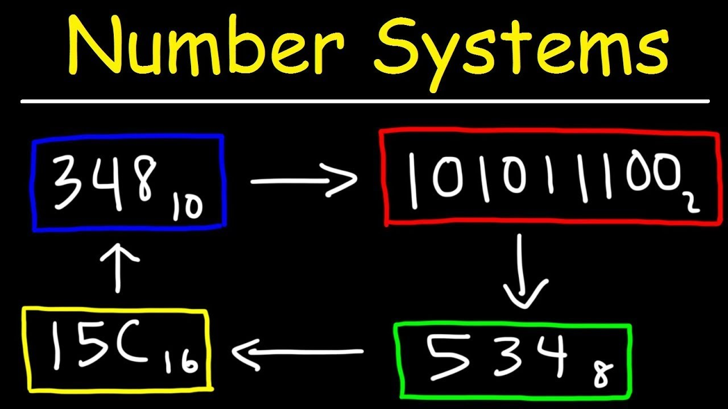
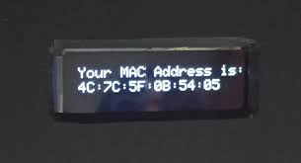
Python Programming: Number System
print(num) Decimal to Binary
print(bin(num)) Binary to Decimal
print(oct(num)) Decimal to Octal
print(hex(num)) Decimal to HexaDecimal
CONCEPTION >> PRACTICE >> CONFIDENCE >> HIGHEST GRADES © PROTECTED ANODIAM 2023 || PRIVATE & CONFIDENTIAL

Slide 8

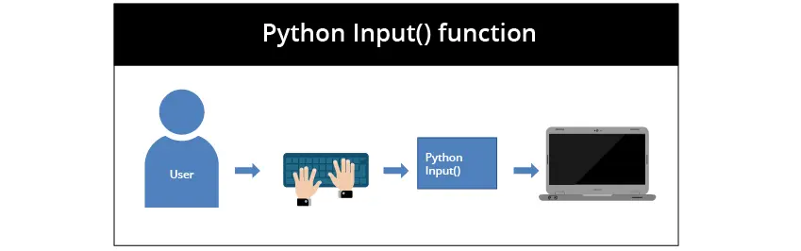
Python Programming: User Input
input(): Delays the execution of program and asks user for input
Strings, Integers, Floats, Characters and Expressions can be asked from the user by passing proper functions inside input()
eval(): Evaluates any mathematical expression
CONCEPTION >> PRACTICE >> CONFIDENCE >> HIGHEST GRADES © PROTECTED ANODIAM 2023 || PRIVATE & CONFIDENTIAL

Slide 9
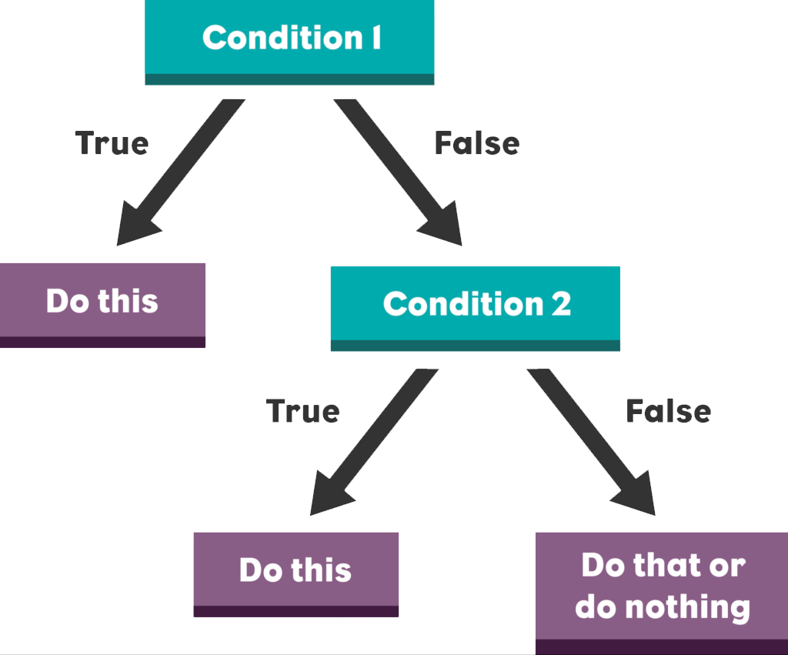
Python Programming: If Else Statement
If Statement: Uses if keyword followed by condition
If-Else Statement: Used to execute both the true part and the false part of a condition. If true, the if block code is executed. If false, the else block code is executed
Nested If: One or more statements present inside another if statement. Used when a variable has to be processed multiple times
If-Elif-Else: It checks the if statement condition. If false, the elif statement is executed. If elif is false, the else statement is executed
CONCEPTION >> PRACTICE >> CONFIDENCE >> HIGHEST GRADES © PROTECTED ANODIAM 2023 || PRIVATE & CONFIDENTIAL

Slide 10



Python Programming: For & While Loops
For: Definite iteration. Iterates predefined number of times
While: Indefinite Iteration. Keeps iterating until the condition is false
The Else Clause: Python exclusive
For Else
While Else
Loop Control Statements:
Break – Terminates the loop
Continue – Forces to execute the next iteration of loop
Pass – Null operation
CONCEPTION >> PRACTICE >> CONFIDENCE >> HIGHEST GRADES © PROTECTED ANODIAM 2023 || PRIVATE & CONFIDENTIAL

Slide 11
Python Programming: Array
Array:
Array can be one dimensional or multi dimensional
Import array module to work with arrays
All elements of an array should be of same type
Can take inputs from user to form an array
Functions:
typecode()
buffer_info()
array()
extend()
append()
pop()
CONCEPTION >> PRACTICE >> CONFIDENCE >> HIGHEST GRADES © PROTECTED ANODIAM 2023 || PRIVATE & CONFIDENTIAL

Slide 12

Python Programming: Numpy
Numpy:
general purpose array-processing package
Used mainly for multidimensional arrays
Efficient even with 1D array. For e.g.- mentioning typecode is not necessary
Array Creation:
array() – array with given data
linspace() – array of range divided in specified number of parts
logspace() – array of range divided in parts but log values
arange() – like linspace but breaks the range in a progressive series
Zeros() – array of 0’s
Ones() – array of 1’s
CONCEPTION >> PRACTICE >> CONFIDENCE >> HIGHEST GRADES © PROTECTED ANODIAM 2023 || PRIVATE & CONFIDENTIAL

Slide 13

Python Programming: More On Array
Array Addition:
Any variable can be added with each element
sum(): Sum of all the array elements
Arrays support various types of mathematical operations
Copying Array:
Aliasing: Assigning an existing array to a new one stored at same address
Shallow Copy: view() function copies the array to form a new but dependent one at different address
Deep Copy: copy() function does the sane but the arrays stay independent
CONCEPTION >> PRACTICE >> CONFIDENCE >> HIGHEST GRADES © PROTECTED ANODIAM 2023 || PRIVATE & CONFIDENTIAL

Slide 14
Python Programming: Matrices
Array Addition:
Any variable can be added with each element
sum(): Sum of all the array elements
Vectorized Operation: Adds elements of two arrays to form a new array
CONCEPTION >> PRACTICE >> CONFIDENCE >> HIGHEST GRADES © PROTECTED ANODIAM 2023 || PRIVATE & CONFIDENTIAL

Slide 15
Python Programming: Vectorized Operation
Array Addition:
Any variable can be added with each element
sum(): Sum of all the array elements
Vectorized Operation: Adds elements of two arrays to form a new array
CONCEPTION >> PRACTICE >> CONFIDENCE >> HIGHEST GRADES © PROTECTED ANODIAM 2023 || PRIVATE & CONFIDENTIAL

Slide 16
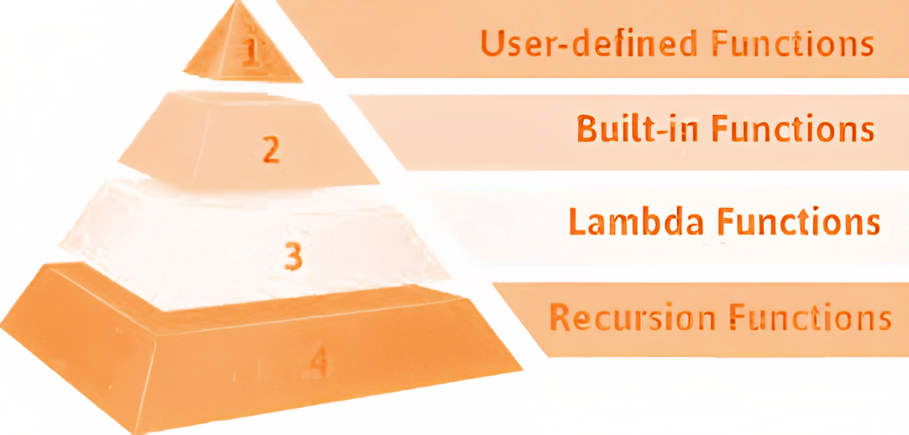
Python Programming: Functions
Function is a block of code which only runs when called
Creating New Function:
def keyword creates a new function
Can assign many functions/statements
Can be called anywhere and anytime
Saves time and space in coding
Nested functions
Return Statement: Used inside a function or method to send the result back to caller
Parameters are variables inside the parentheses in a defined function. e.g. fn(x, y)
Arguments are values sent to the function when it is called. e.g. fn(2, 3)
**Python’s argument passing is neither “pass by value” nor “pass by reference” but “pass by object reference”
CONCEPTION >> PRACTICE >> CONFIDENCE >> HIGHEST GRADES © PROTECTED ANODIAM 2023 || PRIVATE & CONFIDENTIAL

Slide 17
Python Programming: Arguments
ARGUMENTS
ACTUAL
DEFAULT
VARIABLE LENGTH
FORMAL
POSITIONAL
KEYWORD
KEYWORDED
NON-KEYWORDED
Formal arguments are parameters passed while defining a function
Actual arguments are the values passed to the function when called
Default arguments are the values assigned while defining a function
Positional arguments must be specified in the proper order
Keyworded arguments use keys to assign values even if they are not sorted in order
Variable Length arguments are used when the number of values is unknown
e.g. input() where user might give multiple values
*args used for passing a variable number of arguments to a function
**kwargs used for the same as *args but with keys assigned to each of them
CONCEPTION >> PRACTICE >> CONFIDENCE >> HIGHEST GRADES © PROTECTED ANODIAM 2023 || PRIVATE & CONFIDENTIAL

Slide 18

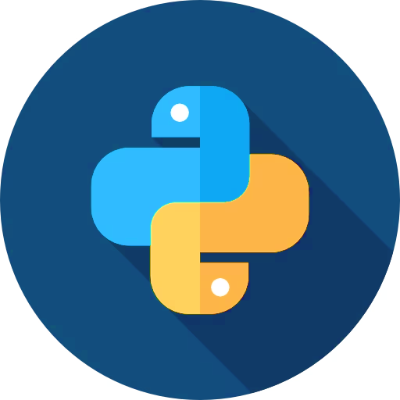
Python Programming: Global Keyword & Recursion
Global variables have a global scope and assigned outside functions
Local variables have a local scope only inside the function they are assigned to
Global Keyword lets access and modify the global variable even inside a function
globals(): function returns the dictionary of current global symbol table
Changes a global variable without affecting local ones if called inside a function
Recursion is a process where a function calls itself
e.g. Program to find factorial of a number
sys.getrecursionlimit(): default limit of recursion is 1000
sys.setrecursionlimt(n): changes the limit of recursion to desired value “n”
CONCEPTION >> PRACTICE >> CONFIDENCE >> HIGHEST GRADES © PROTECTED ANODIAM 2023 || PRIVATE & CONFIDENTIAL

Slide 19
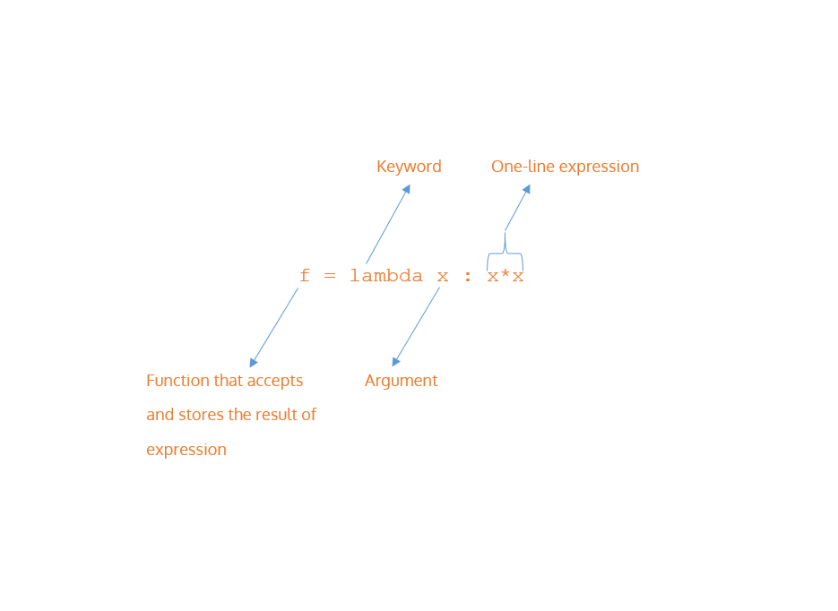
Python Programming: Anonymous Functions
Lambda aka anonymous functions are functions without names
Used when a small, one-time-use function is required
Initiated with the keyword “lambda” instead of “def”
Limitations:
Limited to a single expression.
They are often less readable than named functions
No proper names or docstrings make it harder to understand their purpose
CONCEPTION >> PRACTICE >> CONFIDENCE >> HIGHEST GRADES © PROTECTED ANODIAM 2023 || PRIVATE & CONFIDENTIAL

Slide 20
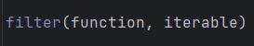
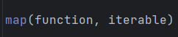
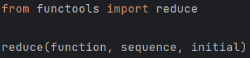
Python Programming: Filter Map & Reduce
Abcd
Efgh
Ijkl
filter() is an in built function used for fetching elements from a collection (e.g. list or array) based on a set condition
map() function transforms each element in a collection using a given function by applying it to each element
reduce() aggregates elements in a collection to produce a single result by repeatedly applying a binary function to them
** initial can be assigned with a value to be aggregated with the passed sequence
A
a
I
i
E
e
a
i
aei
e
CONCEPTION >> PRACTICE >> CONFIDENCE >> HIGHEST GRADES © PROTECTED ANODIAM 2023 || PRIVATE & CONFIDENTIAL

Slide 21

Python Programming: Decorators
Decorators can modify functions (or methods) and classes without changing the source code
Functions are first-class citizens in python, which means they can be:
passed as arguments to other functions
returned as values to other functions
defined within other functions
The above properties validate decorators
Example – “@timeit” decorator measures execution time of a code
CONCEPTION >> PRACTICE >> CONFIDENCE >> HIGHEST GRADES © PROTECTED ANODIAM 2023 || PRIVATE & CONFIDENTIAL

Slide 22
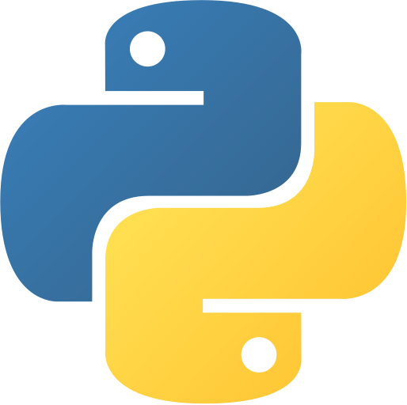
Python Programming: Special Variables
Special Variables can provide details on the context, behavior or state of a code in Python
Always defined using double underscores (e.g. “__name__”)
They are also known as dunder or magic methods
Examples:
__name__ contains the name of current module
__name__ shows '__main__' if the current script is running
If imported as a module into another script, __name__ shows the module's name
__init__ is called when an object is created from a class and used to initialize the object's attributes
__del__ is called for destroying an object and sending it for garbage collection
__str__ is called by the str() function to generate a string that represents the object's state
__call__ allows instances of a class to be called like functions
__iter__ and __next__ are used to define iterators for custom objects
CONCEPTION >> PRACTICE >> CONFIDENCE >> HIGHEST GRADES © PROTECTED ANODIAM 2023 || PRIVATE & CONFIDENTIAL

Slide 23
Python Programming: Object Oriented Programming
OOPs
CLASS
OBJECT
INHERITANCE
ENCAPSULATION
POLYMORPHISM
ABSTRACTION
OOPs is a programming prototype that enables problem solving in a real world approach
Shows how versatile Python is, based on programming spectrum
Strings, Integers, Floats, Lists, Sets etc. are examples of built-in objects
To define an object, declaring a class is necessary
Classes contain attributes and behaviors of objects
CONCEPTION >> PRACTICE >> CONFIDENCE >> HIGHEST GRADES © PROTECTED ANODIAM 2023 || PRIVATE & CONFIDENTIAL

Slide 24


Python Programming: Objects & Classes
Class offers a blueprint for user-defined objects
Contains attributes(variables) and behaviors(methods) for the objects
Provides a way to organize code by grouping related data and behavior together
Keyword for creation is class
By convention class name should be typed in camel-case
Object is an entity with attributes and behaviors
For example, an object Parrot has
attributes - age, color
behavior - flying, singing
which belongs to the class “Parrot”
Objects are instances created from the class
CONCEPTION >> PRACTICE >> CONFIDENCE >> HIGHEST GRADES © PROTECTED ANODIAM 2023 || PRIVATE & CONFIDENTIAL

Slide 25

Python Programming: Constructors & Encapsulation
Constructors initialize objects and allocate memory (in Heap Memory) to them
__init__ method lets the class assign attributes for objects
self keyword (by convention) represents an instance (object) of the given class
Constructors are generally of two types
Default (Non-parameterized) does not accept any arguments except from self
Parameterized accepts arguments aside from self
Encapsulation is a OOPs concept that ensures a conventional restriction of data
Wraps the variables and the methods together as a single unit
The idea is ensuring the variables can be accessed only through the methods of their current class
Constructors can be used for achieving encapsulation
CLASS
VARIABLES
METHODS
CONCEPTION >> PRACTICE >> CONFIDENCE >> HIGHEST GRADES © PROTECTED ANODIAM 2023 || PRIVATE & CONFIDENTIAL

Slide 26

Python Programming: OOPs Variable Types
Instance Variables (Attributes) are specific to an instance of a class
Stores unique data to each object created from the class
Object level
Class Variables (Static Variables) are shared by all instances of a class
Defined within the class but outside of any instance methods
Same for all instances of the class (Class level)
Can be accessed using the class name or any instance of the class
Local Variables are defined within methods or functions (Method level)
Only accessible within those
They have no connection to the class or its instances
Variables…
VARIABLES
METHODS
CONCEPTION >> PRACTICE >> CONFIDENCE >> HIGHEST GRADES © PROTECTED ANODIAM 2023 || PRIVATE & CONFIDENTIAL

Slide 27

Python Programming: OOPs Method Types
Instance Methods are meant to access the instance attributes
Takes self as parameter
The most commonly used method
Accessors fetch (get) the value and Mutators modify (set) the value
Class Methods are usually used to access class variables
Can be called using the class name itself
Takes cls as parameter
Declared by @classmethod decorator
Static Methods are not associated with either of the class or instance variables
Takes no parameters
Declared by @staticmethod decorator
Can be accessed using the class name as well as class objects
Methods…
VARIABLES
METHODS
CONCEPTION >> PRACTICE >> CONFIDENCE >> HIGHEST GRADES © PROTECTED ANODIAM 2023 || PRIVATE & CONFIDENTIAL

Slide 28
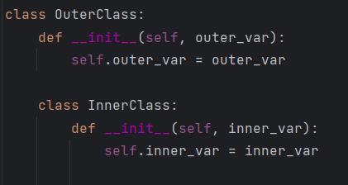
Python Programming: Inner Class
Inner Classes or nested classes are basically one defined inside the other
Useful for grouping two related classes
Better privacy of code
Inner classes are of two types, as follows
Multiple: The class contains one or more variables
Multilevel: The class contains an inner class which contains another inner class
VARIABLES
METHODS
CONCEPTION >> PRACTICE >> CONFIDENCE >> HIGHEST GRADES © PROTECTED ANODIAM 2023 || PRIVATE & CONFIDENTIAL

Slide 29
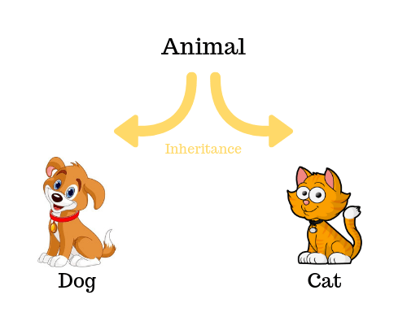
Python Programming: Inheritance
Inheritance is a OOPs concept that allows a class to inherit attributes and behaviors from another class
Provides reusability of the code and increases its performance
Parent Class (Super Class) is the class whose properties are inherited by the new one
Child Class (Sub Class) derives its properties from its parent class aside from having its own
CONCEPTION >> PRACTICE >> CONFIDENCE >> HIGHEST GRADES © PROTECTED ANODIAM 2023 || PRIVATE & CONFIDENTIAL

Slide 30
Python Programming: Inheritance Types
SINGLE LEVEL
MULTIPLE
HIERARCHICAL
Parent
Child 1
Child 2
Child 3
Parent
Child
Child
Parent 1
Parent 2
VARIABLES
MULTILEVEL
HYBRID
Class A
Grandparent
Parent
Child
Class B
Class D
Class C
Class E
Class F
CONCEPTION >> PRACTICE >> CONFIDENCE >> HIGHEST GRADES © PROTECTED ANODIAM 2023 || PRIVATE & CONFIDENTIAL

Slide 31

Python Programming: Method Resolution Order
MRO…
MRO is an order in which classes are searched when looking for a method or attribute in an inheritance hierarchy
Modern Python uses C3 Linearization algorithm over the old school DLR
Example: In Case of A(B,C) – MRO dictates that the code will first search A itself, then go to B and then C
Left to Right
Super() is a built-in function which allows access to the parent’s methods and attributes in the child class
Follows MRO
CONCEPTION >> PRACTICE >> CONFIDENCE >> HIGHEST GRADES © PROTECTED ANODIAM 2023 || PRIVATE & CONFIDENTIAL

Slide 32




Python Programming: Polymorphism
Polymorphism means having multiple forms in general
Provides code flexibility and reusability
len() is an in-built polymorphic function
Functions or methods with same name make different objects behave in similar pattern
transport()
CONCEPTION >> PRACTICE >> CONFIDENCE >> HIGHEST GRADES © PROTECTED ANODIAM 2023 || PRIVATE & CONFIDENTIAL

Slide 33



Python Programming: Duck Typing
"If it looks like a duck, swims like a duck and quacks like a duck, then it probably is a duck”
QUACK!
Duck Typing is an idea of assigning types to classes based on similar methods
Python is a dynamically typed language which dictates:
The type or class of an object is determined by its behavior
Declaring the type of an object explicitly is unnecessary
CONCEPTION >> PRACTICE >> CONFIDENCE >> HIGHEST GRADES © PROTECTED ANODIAM 2023 || PRIVATE & CONFIDENTIAL

Slide 34

Python Programming: Operator Overloading
OVERLOAD…
Operator Overloading lets us define how operators behave for objects of custom classes
Operators in python actually calls certain special methods behind the scene
“ + ” calls __add__
“ - ” calls __sub__
“ * ” calls __mul__
Custom operations can be defined by modifying those special methods
For e.g. adding two objects by inducing new addition logic to __add__
CONCEPTION >> PRACTICE >> CONFIDENCE >> HIGHEST GRADES © PROTECTED ANODIAM 2023 || PRIVATE & CONFIDENTIAL

Slide 35
Python Programming: Method Overloading & Overriding
Method Overloading defines multiple methods with the same name but different parameters
Compile time Polymorphism
Is implemented within the same class
Python does not support this by default which makes the latest definition valid for the overloaded method
Method Overriding defines a new implementation for a method in a subclass that already exists in the parent class
Run time Polymorphism
Works within at least two classes (or more) related via inheritance
Methods must have same name and parameters
OVERLOADING
OVERRIDING
CONCEPTION >> PRACTICE >> CONFIDENCE >> HIGHEST GRADES © PROTECTED ANODIAM 2023 || PRIVATE & CONFIDENTIAL

Slide 36
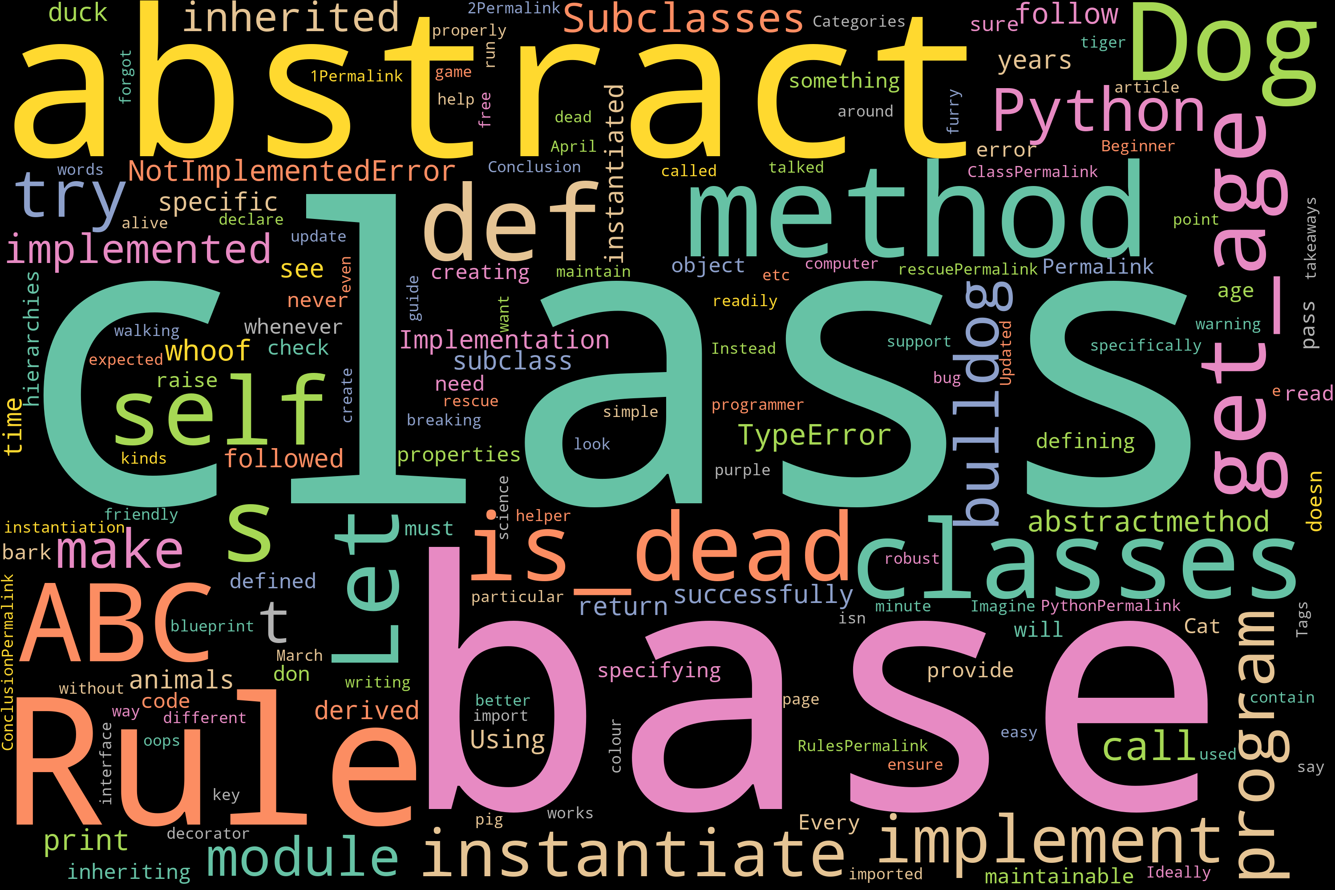
Python Programming: Abstract Methods & Classes
Abstract Methods are declared but not implemented
Defined using @abstractmethod decorator
Need to import ABC (Abstract Base Classes) module
Python does not support this by default
Abstract Classes are classes that contain at least one abstract method
Used for building API (Application Program Interface)
Serves as a blueprint for other classes
Objects can not be created from them
CONCEPTION >> PRACTICE >> CONFIDENCE >> HIGHEST GRADES © PROTECTED ANODIAM 2023 || PRIVATE & CONFIDENTIAL

